Slide 1


OpenMed Association cooperation for enhancing the Mediterranean Business Environment
Tunis, June 28th 2018
by Emanuele Cabras, OpenMed President

Slide 2

OpenMed Presentation
Best practices from past experiences on regional EU co-financed projects
The contribution of OpenMed in the consolidation of the Mediterranean Business Environment
OpenMed needs, expectations and target group representation Scheduled Activities as GACIC affiliate
INDEX

Slide 3


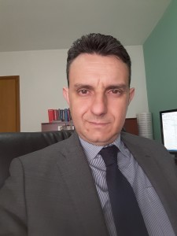



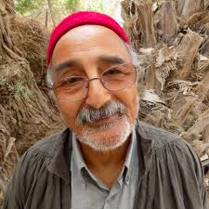
OpenMed Presentation
EMANUELE CABRAS,
President
DANIELE COCCO,
Coordinator
FEDERICA ROMANO,
Vice-President
CLAUDIA SEDDA,
Comm. Manager
IHAB SOLIMAN
MESSAOUD YAMOUN

Slide 4












Slide 5
The Association
Organization: OpenMed assembles a group of professionals and experts with multi-annual experience in the field of cooperation with a strong belief in potentialities and added values of exchange processes among organizations, institutions and people of the Mediterranean boosting different cultures, habits and backgrounds
Philosophy (vision): the Association looks positively at new challenges like globalization and a growing “melting-pot” society where people are more and more encouraged to interact with new communities, environments, cultures, habits and identities
Mission: OpenMed operates to strongly promote integration and exchange occasions through the implementation of a vast range of international cooperation projects and initiatives in particular among Mediterranean countries (e.g. Summer School and others)
OpenMed presentation

Slide 6
Insight into OpenMed: Activities
Involvement in economic, cultural and social research studies;
Participation to cooperation initiatives funded by EU / other donors;
Administrative, financial and technical project management;
Monitoring of projects through web-based system OpenMed- Pro;
Evaluation of project ideas to be submitted to the EU;
Support for cross-border partnerships in the Euro-Mediterranean area;
Support for the preparation and submission of project proposals;
Management of relationships with EU Programs’ M.A.s;
Information and training seminars on topics of interest;
Organization of the Euro-Mediterranean Cooperation Summer School.
OpenMed presentation

Slide 7
Best practices from past experiences on regional EU co-financed projects

Slide 8
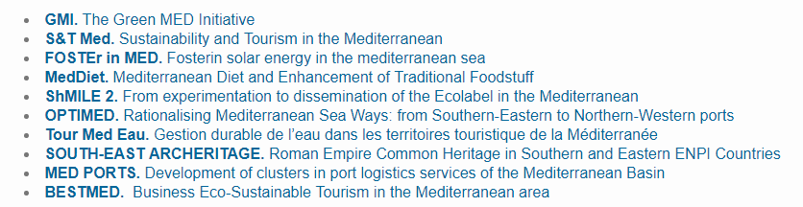
Best practices: MedDiet

Slide 9


MedDiet project
MedDiet project
“MedDiet - Mediterranean Diet and enhancement of traditional foodstuff”;
Beneficiary: UnionCamere (Italy, Lazio);
12 additional PPs from 6 countries (Italy, Spain, Greece, Lebanon, Tunisia and Egypt);
Duration: 30 months (January 2013 – 31/12/2015);
Budget: about 5 Mil. €.
Specific objective:
Increase the awareness of consumers (in particular young people and children and SMEs (in particular restaurants) about the benefits of the Mediterranean Diet (M.D.) by reinforcing the capacity of commerce chambers / business organizations, schools, local authorities and policy making institutions to implement effective and sustainable initiatives for safeguarding M.D. in Italy, Spain, Greece, Tunisia, Egypt and Lebanon
Best practices: MedDiet

Slide 10


Main activities and best practices:
165 nutrition education initiatives for schools and consumers including taste laboratories, visits to farms/factories, cooking courses, schools vegetables gardens;
Creation of a MedDiet Quality Label for restaurants and pilot actions for its implementation (training courses and technical assistance programs for restaurant owners);
Establishment of 20 “Mediterranean Diet info points”;
Drafting of a “shared Mediterranean system for the safeguard of traditional product of the MedDiet” to be signed by national representatives of Ministries/agencies of the involved countries.
Best practices: MedDiet

Slide 11

EuroMediterranean Cooperation Summer School
Best practices: ……

Slide 12
OpenMed and the consolidation of the Mediterranean Business Environment

Slide 13

Maximize exchanges between Business Support Organizations and SMEs
Funding exchange opportunities for BSOs and SMEs in the Med area
Possible initiatives for cooperation projects between BSOs
Main funding opportunities
ENI CBC MED Program
CROSS BORDER COOPERATION WITHIN THE EUROPEAN
NEIGHBOURHOOD INSTRUMENT (ENI)
MEDITERRANEAN SEA BASIN PROGRAMME 2014-2020
Funding opportunities

Slide 14
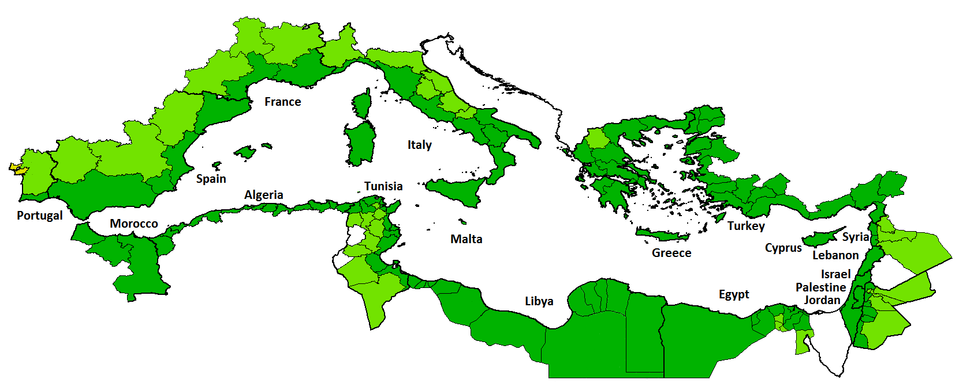
ENI CBC Med 2014-2020 – Geographical eligibility
Eligible regions
Adjoining regions
Major center
ENI CBC Med

Slide 15
ENI CBC MED – Strategy/Budget 2014-2020 Overview
Promote economic and social development
€ 112.860.000 (60%)
1. Business and SME development
2. Support to education, research, technological development and innovation
3. Promotion of social inclusion and fight against poverty
€ 45.144.000
€ 33.858.000
€ 33.858.000
1.1 Support innovative start-up and recently established enterprises
2.1 Support technological transfer and commercialisation of research results
3.1 Provide young people, especially those belonging to the NEETS and women, with marketable skills
1.2 Strengthen and support networks, clusters, consortia and value-chains
2.2 Support SMEs in accessing research and innovation
3.2 Support social and solidarity economic actors
1.3 Encourage sustainable tourism initiatives and actions
ENI CBC Med

Slide 16
ENI CBC MED - Type of Projects
I. Standard projects
Open Call (all priorities)
Networks
Piloting
Features
45% = 84,6 M€
EU support:1-3 M€ (max 90%)
Min. 3 countries (1 MPC or 1 EUPC)
Max. 3 partners from the same country
Max. duration: 3 years
ENI CBC Med

Slide 17
ENI CBC MED - Type of Projects
II. Strategic projects
ToRs
Wider impact
Replicability
Features
45% = 84,6 M€
EU support: 2,5-6 M€
Min. 4 countries (2 MPC or 2 EUPC)
Max. 3 partners from the same country
Max. duration: 4 years
ENI CBC Med

Slide 18
ENI CBC MED - Type of Projects
III. Capitalisation projects
Contribution to public policies
Exploitation dissemination
Good practices
Features
10% = 18,8 M€
EU support: 500.000 € - 1 M€
Min. 5 countries (1 MPC or 1 EUPC)
Max. 3 partners from the same country
Max. duration: 2 years
ENI CBC Med

Slide 19
ENI CBC MED - Call for Proposals
I. Indicative timeframe
Standard
Closed on Jan 24th 2018
Strategic
End of 2018
Capitalisation
2020?
ENI CBC Med

Slide 20

ENI CBC MED - Call for Proposals
First pre-financing installment: 40% of the total ENI budget from the entry in force of the grant contract
II. Financial rules
EU contribution
Up to 90% of the total eligible costs
At least 50% of the budget allocated to activities in MPC
Preparation costs: Max.10 000 €
Subgrants: Max. 60 000 € (for third parties). Max. 30% of total eligible costs
ENI CBC Med

Slide 21
OpenMed needs, expectations and target group representation

Slide 22
Possible initiatives for cooperation projects between BSOs
Business and SMEs development
Network of BSOs supporting cross-border start-up and recently established enterprises
Activities
Training, mentorship, tutorship provided to young entrepreneurs
Investment schemes with risk capital dedicated and accessible to start-ups
Local hubs and accelerators created to train/coach and host talents
Existing “one-stop-shop” service providers specialized in support services for start-ups
ENI CBC Med

Slide 23
Possible initiatives for cooperation projects between BSOs
Business and SME development
Networks of BSOs supporting SMEs networks, clusters, consortia
Activities
Quality consultancy services provided to SMEs
International business events
Public Private Partnerships between public actors and enterprises formally established
New joint products / brands developed
ENI CBC Med

Slide 24
Possible initiatives for cooperation projects between BSOs
Technological development and innovation
Networks of BSOs and Research Center supporting technological transfer
Activities
Living labs and/or collaborative platforms to match of innovation seekers (SMEs) and technological solvers (research actors/Universities)
Science to business brokerage events/fairs organised (e.g on market opportunities for researches and business actors).
Cross-border innovation advisory support services developed (e.g. Innovation Voucher, Product & Idea development, Market Research, Sales, Finance and Funding, Networking, etc.).
ENI CBC Med

Slide 25
Thanks for your attention!
e.cabras@open-med.eu
www.open-med.eu
www.euromedsummerschool.eu

