Slide 1
EBSO Med Inès Briard – EUROCHAMBRES 28.06.2018

Slide 2
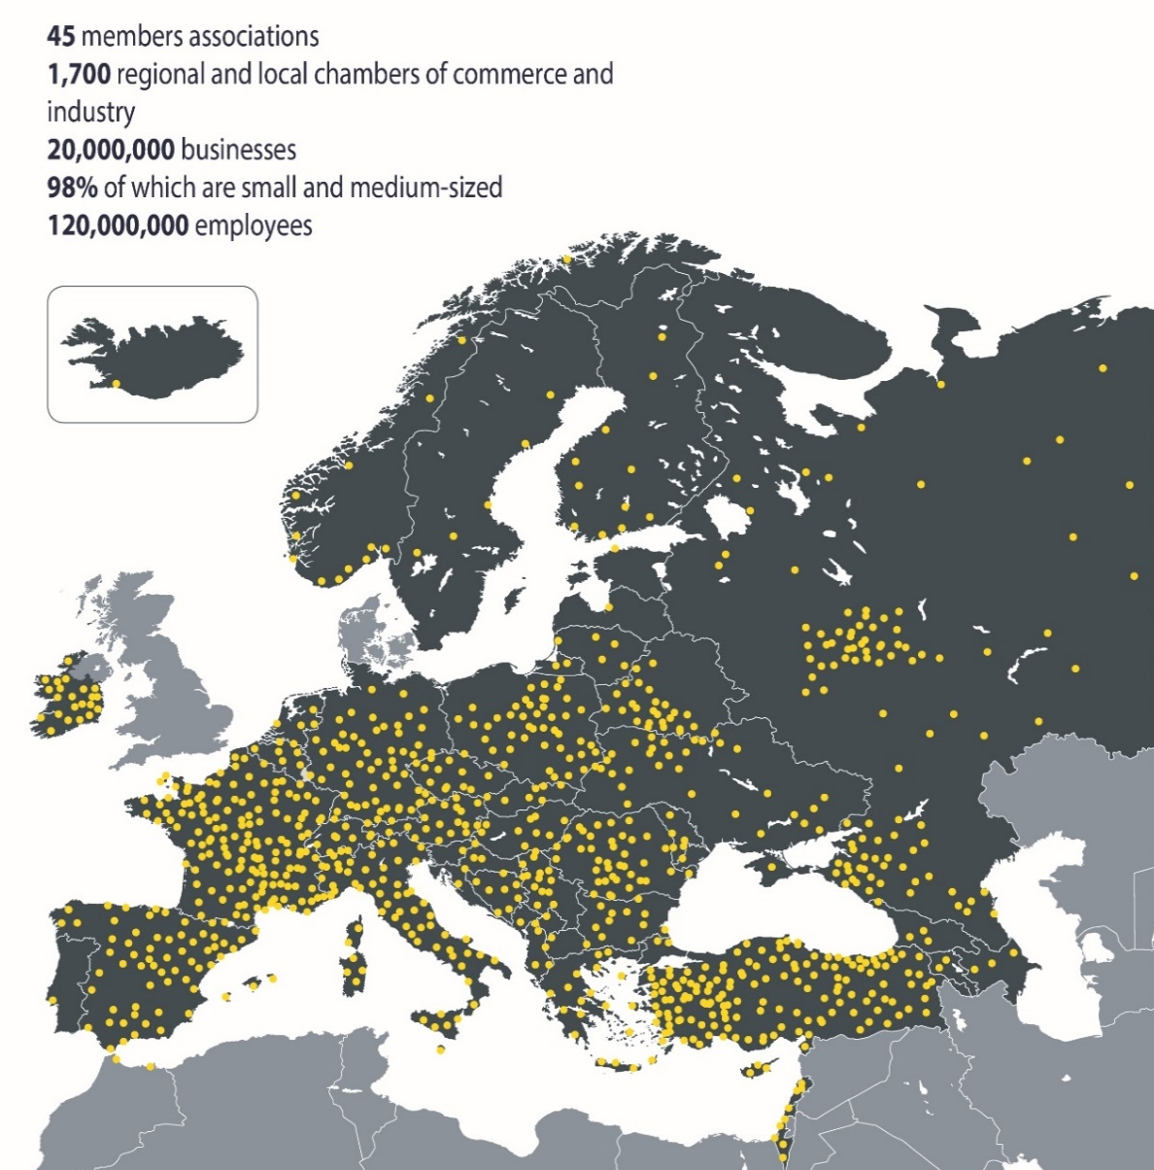
EUROCHAMBRES & Members
Association of European Chambers of Commerce and Industry
Missions:
Develop a business-friendly, competitive economic environment in Europe
Strengthen the voice and position of European Chambers
Develop benchmarking, networking and transfer of know how within the Chamber network
Document’s title

Slide 3
Proposed Activities
EBSO Med Chamber Academies
EU Roadshows
Quality Label

Slide 4
EBSO Med Chamber Academy
Mixing EU and South Med BSO executives => increase interaction
Max 50 BSO staff per academy: selection process !
1 academy per year; first edition Spring 2019 - Milan
Course leaders: EU and Southern Med BSO experts
Interactive approach: small groups, parallel classes, role games
Certificate at the end
Core Courses and Optional Courses => tailor made programme

Slide 5
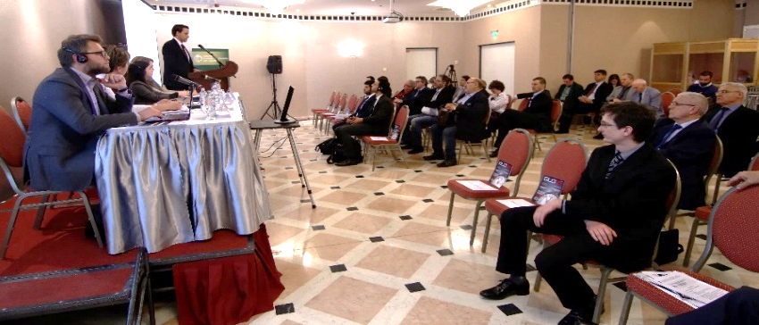
EU-Med Roadshows in Europe
Improve the image & inform EU Companies about the economic context
Increase the understanding among EU entrepreneurs
Present regional pool of competences and the existing opportunities
Target EU BSOs & SMEs with a potential interest in the region
6 roadshows visiting 2 countries each:
BE, BG, CY, FR, GR, HU, IT, LV, PL, PT, ES, TR
Participants: EU SMEs / Entrepreneurs
Speakers: Med SMEs & BSOs
1st event: Sept / Oct 2018:
Spain & Portugal on Maghreb region
Share success stories of Euro-Med entrepreneurs
Promote opportunities for investment and business partnerships

Slide 6
Labelling BSO Service
Objectives
Provide evidence of quality of BSO services to their members & wider public
Tool
Conditions for success
Ownership
Improve the quality of BSO’s activities
secure BSOs’ sustainability and increase the impact of their actions
Design
Promotion and marketing
Quality label for BSOs services in a given country or sector (similar to ISO)
Single coherent network of local business support organisations offering highest quality representation, service & support
Interested Southern BSOs to start a collaboration with EU counterparts on the quality label are encouraged to send an email to Dirk Vantyghem: vantyghem@eurochambres.eu
Document’s title

Slide 7
Thank you & for more information, please contact: Inès Briard, briard@eurochambres.eu

