Slide 1
PIEMONTE AGENCY: the one stop shop for business and investments in Piemonte - Italy
Tunis, June 28th 2018

Slide 2
ABOUT US
Since 1976 dealing with internationalization
In 2006 merging of several bodies
First italian organization dedicated to internationalization
To boost the international role of Piemonte and its potentials
A team of experts for your business: nothing is too technical, too challenging or too far for us
PIEMONTE AGENCY

Slide 3
Business opportunities
Matching foreign companies’ needs
with the local production offer
Matching foreign companies’ needs
with the local production offer
We can
carry out projects for partners’ research
provide tailored solutions
build a structured framework to fit your needs
suggest the best systemic solution
provide a “Solution Manager”
n
n
Our services
Personalised - targeted - free
PIEMONTE AGENCY

Slide 4
Inward Investment
Piemonte Agency: the key reference point
for foreign enterprises wishing to locate in Piemonte
We can
advise on every aspect for starting and running a business in Piemonte
support foreign companies which have already invested in Piemonte
provide assistance at every stage of the investment project
n
n
Our services
responsive
tailored to your needs
totally confidential free
PIEMONTE AGENCY

Slide 5
Our focus
Design & Luxury
Aerospace
Agrifood
Automotive
CleanTech
Mechatronics
Health & Wellness
Textile
PIEMONTE AGENCY

Slide 6
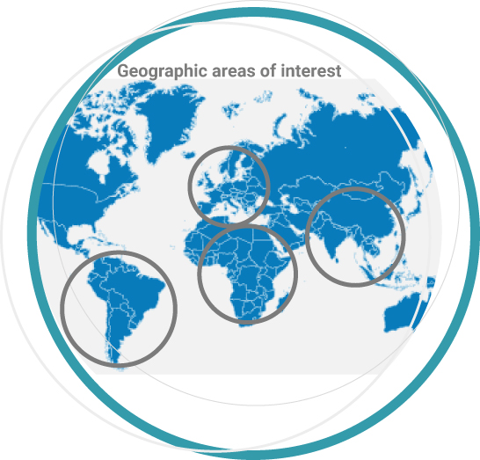
Fundraising
Scouting of financial opportunities
Project identification, feasibility evaluation and analysis
Partnership creation
Project design and implementation
Report
Follow-up
Scouting of financial opportunities
Project identification, feasibility evaluation and analysis
Partnership creation
Project design and implementation
Report
Follow-up
UE
Caucasus
Mediterranean
Countries
Asia
Africa
Latin America
PIEMONTE AGENCY

Slide 7
CEIPIEMONTE ADDED VALUE TO EBSOMED PROJECT
Extensive and multi stakeholder representation: policy makers and BROs, enterprises, academic institutions
Fundraising , Project Financing and International Projects
Highly qualified staff: market and sectors expertise
Investment Promotion , Merger & Acquisition
PIEMONTE AGENCY

Slide 8
BEST PRACTICES UNDER EUROMED INVEST PROJECT
AS LEAD PARTNER
Business Road show in Jordan (September 2016)
BSO Mentoring Programme with SEBC Syria (Novembre2016)
Roadshow Morocco (May 2017)
AS PARTNER IN ACTIVITIES COORDINATED BY OTHER PARTNERS
Participation in Tech Agrifood (2014)
Participation in SIPSA Algeria (2015)
Roadshow «Green Solutions in MED»
PIEMONTE AGENCY

Slide 9
Thank you
Piemonte Agency
www.centroestero.org
Corso Regio Parco, 27
10152 Torino – Italy
tel. +39 011 6700511 fax +39 011 6965456
info@centroestero.org

