Slide 1
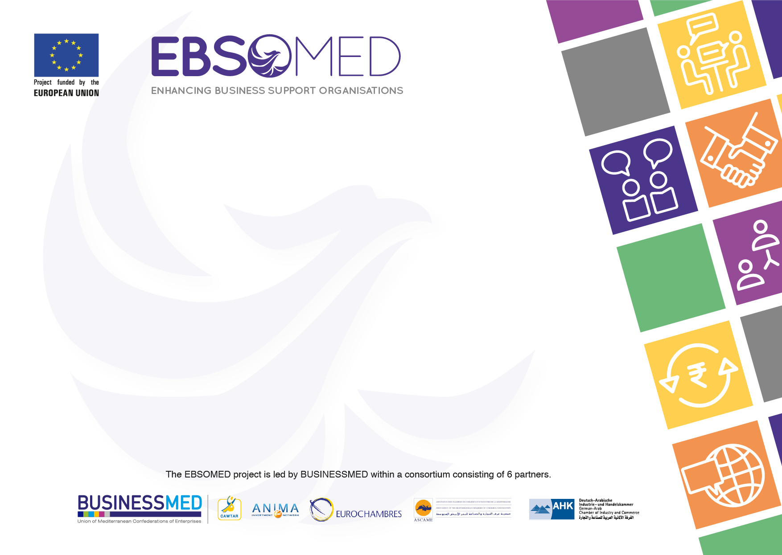

The Chamber of Commerce, Industry & Agriculture of Beirut & Mount Lebanon
CCIA-BML
Experiences & Prospects
within EU Projects

Slide 2

CCIA-BML: A Leading Institution at the service of Private business
A non-profit private organization working for the public benefit;
The largest Lebanese business support institution with a membership roaster of 15.000 enterprises covering the main economic sectors;
Over 130 years of dedication to the interest of the private economy;
An institution attuned to change: Keep up with Modernity is the prevailing motto;
The Chamber mission is to instigate the Lebanese private sector and to uphold the national economy.
Notes:
Let me first introduce briefly our Chamber:

Slide 3
Extensive Experience in EU Projects
Leader / partner role in 7 ENPI CBC MED projects (2013-2017) for a budget of 3 million euros;
Extensive coverage of key business sectors: Solar energy (SHAAMS), diaspora (MedGeneration), waste management (GMI), Agro food (MedDiet), maritime transport (OPTIMED) mediation & mentoring (EuroMedInvest), etc.
Active partner in EU educational programs to better adapt education to labor market:
  Tempus (Academic);
  GIZ & ETF (TVET);

Slide 4
Impact Across Previous Projects
Reinforcing intra Euro Mediterranean trade potential through business matching and roadshows
Increasing investment potential
Upgrading businesses through partnerships & joint ventures
Raising proficiency of local human resources through know how transfer & capacity building programs
Drive for Job creation
Human & cultural exchange

Slide 5
CCIA-BML Key Strengths
The Chamber is backed by:
Wide outreach to the Lebanese business market: Pool of 15.000 member enterprises, representing 70% of the Lebanese business activity.
Dynamic presence on regional and international scenes: EU, World Bank, WCFICC, ASCAME, ILO, USAID, UNIDO, joint chambers and business councils, etc.
Large scale of resources to ensure projects sustainability: Human capital, financial capacity, state- of- the- art facilities: LTC, CER, LAMC, ..
Aggressive visibility tools: e-newsletter (10.000 recipients), website ( 1000 visitors monthly) & active social media platforms (120k likers).

Slide 6
Expectations within EBSOMED
Optimising the transmission of skills and competencies to Lebanese BSOs & SMEs :To better serve SMEs path to internationalisation;
Upscaling the quality and model of services offered by the Chamber and Lebanese SMEs;
Engendering new partnerships/MoUs with analogue EUROMED BSOs/SMEs;
Main target group: the Chamber, member enterprises, Lebanese BSOs with focus on youth and women
CCIA-BML: Experiences & Prospects within EU Projects

Slide 7
The Chamber of Commerce, Industry & Agriculture of Beirut & Mount Lebanon
CCIA-BML
THANK YOU

