Slide 1


AFAEMME
(Association of Organisations of Mediterranean Businesswomen )

Slide 2

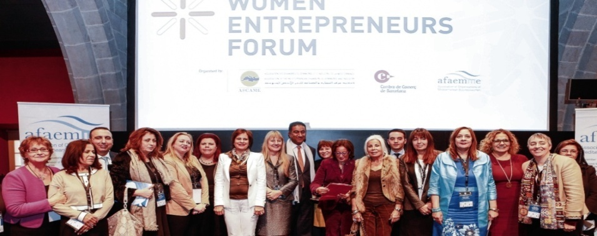

AFAEMME PRESENTATION
THE ASSOCIATION OF ORGANISATIONS OF MEDITERRANEAN BUSINESSWOMEN (AFAEMME) IS A FEDERATION OF BUSINESSWOMEN ASSOCIATIONS WHICH WAS LAUNCHED IN 2002 IN BARCELONA (SPAIN) AND WHICH CURRENTLY COMPRISES 51 MEMBER ORGANISATIONS FROM 24 MEDITERRANEAN COUNTRIES.

Slide 3

AFAEMME ROLES
A NETWORKING PLATFORM FOR WOMEN ENTREPRENEURS
LARGEST FEDERATION
OF BUSINESSWOMEN ASSOCIATIONS IN THE MEDITERRANEAN AREA
EURO-MEDITERRANEAN LOBBY ORGANISATION WHICH ADVOCATES FOR A BETTER ACCESS OF WOMEN TO ECONOMIC DECISION-MAKING POSITIONS.
A COORDINATOR OF EUROPEAN AND MEDITERRANEAN
BUSINESS AND GENDER PROJECTS AND GROUND-BREAKING RESEARCH

Slide 4
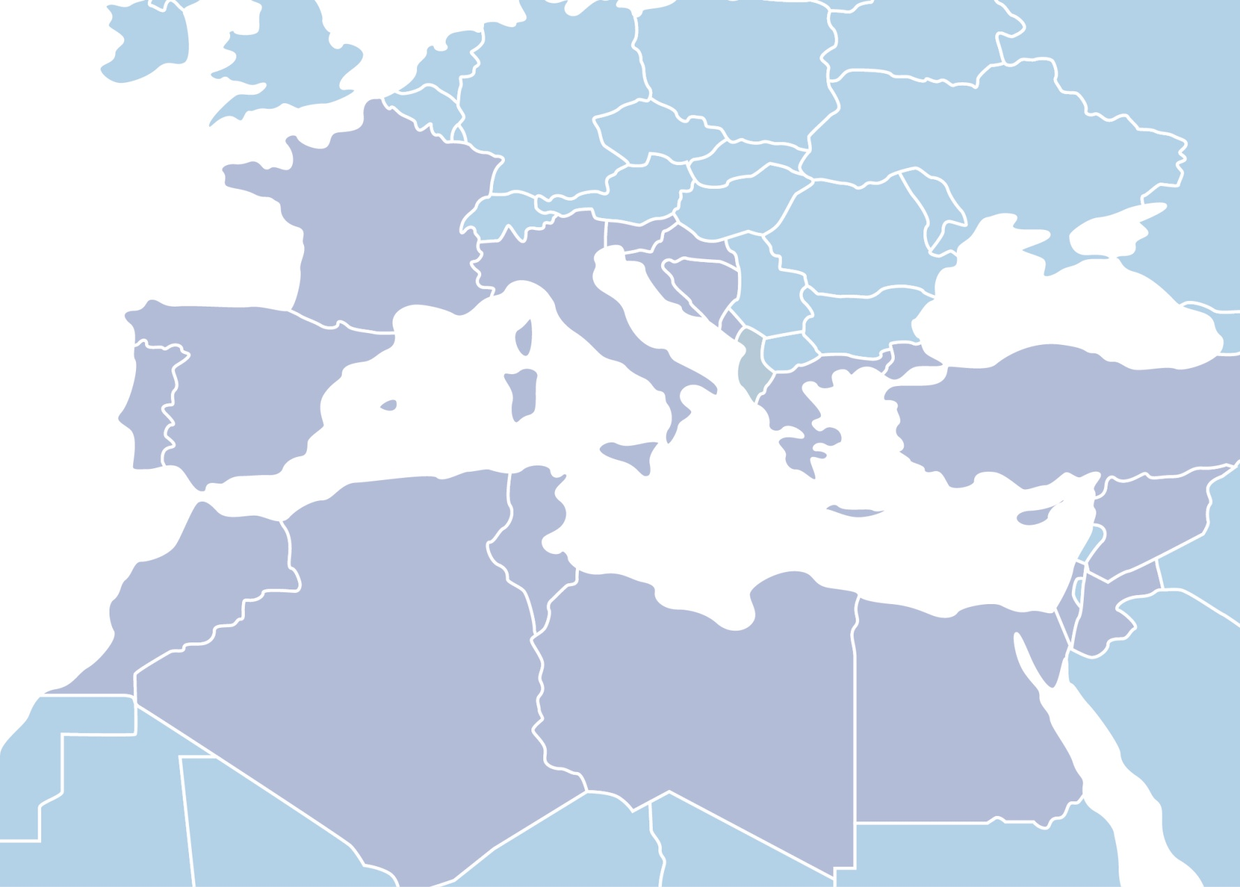
AFAEMME MEMBERS

Slide 5
AFAEMME MEMBERS
ALBANIA: Professional & Business Women Association Albania
(PBWA - SHGPA)
ALGERIA: Association des Femmes Algériennes Chefs
d'Entreprises (SEVE) Association Algérienne des Femmes
Managers et Entrepreneurs (AME)
Association des Femmes Cadres Algériennes (AFCARE)
BOSNIA- HERZEGOVINA: Association of Businesswomen of
Bosnia and Herzegovina (ONE)
CROATIA: Croatian Association of Businesswomen (KRUG)
CYPRUS: Cyprus Federation of Business and Professional
Women
EGYPT: Egyptian Business Women Association (EBWA)
Association for Women’s Total Advancement & Development
(AWTAD)
FRANCE: Femmes Chefs d'Entreprises (FCE)
GREECE: Greek Association of Women Entrepreneurs (SEGE)
ITALY: International Federation Business and Professional
Women (FIDAPA) CNA Impresa Donna Terziario Donna
Confcommercio Women Entrepreneurship (APID)
Young Women Entrepreneurs Association (YWEA)
Italian Women in the World (IWW)
Associazione Donne Imprenditrici e Dirigenti di Azienda (AIDDA)
Women at Work Italia (W@WITALIA)
JORDAN: Jordan Forum for Business & Professional Women
(JFBPW)
LEBANON: Lebanese Business Women Association (LBWA)
Young Arab Women Entrepreneurs (YAWE)
LIBYA: Libyan Women Forum (LWF)
MALTA: Malta Association of Women in Business (MAWB) Foundation for Women Entrepreneurs
MONTENEGRO: Businesswomen Association Montenegro (Poslovna Zena)
MOROCCO: Association of Businesswomen of Morocco (AFEM)
PALESTINE: Palestinian Business and Professional Women Association (BPW-Ramallah)
PORTUGAL: Association of Businesswomen in Portugal (AMEP)
PRINCIPALITY OF MONACO: Ass. Femmes Chefs d’Entreprise (AFCEMonaco)
SLOVENIA: Association of Women Entrepreneurs - GIZ Podjetnost
SPAIN: ASSOCIATION OF BUSINESSWOMEN OF ALICANTE (AFYDE)
Federation of Businesswomen of Andalusia (FAME)
Association of Businesswomen of the Balearic Islands (ASEME)
Association of Businesswomen of Castellon (APMC)
Businesswomen Organization of Catalonia (ACEE)
Organisation of Business & Professional Women Murcia (OMEP)
Ass. for the Development of Businesswomen of Valencia (ADE)
SYRIA: Modernizing & Activating Women's Role in Economic Development (MAWRED)
TUNISIA: Chambre Nationale des Femmes Chefs d’Entreprises (CNFCE)
TURKEY: Women Entrepreneurs Association (KAGIDER)
Association of Businesswomen in ANTALYA (ANTIKAD)
Ankara Businesswomen Entrepreneurs & Enhancement Association (ANGIKAD)
Association of Business Women in Izmir (IZIKAD)
Kadin Eckonomic Platform (KEP)
Producer Women Solidarity Association (YOZGAT)
UNITED KINGDOM: Arab International Women’s Forum

Slide 6

AFAEMME OBJECTIVES
PROMOTE
THE PRINCIPLE OF EQUAL OPPORTUNITIES IN THE LABOR MARKET
SUPPORT
THE DEVELOPMENT OF RELATIONS AMONG WOMEN ENTREPRENEURS OF THE REGION BY PROMOTING BUSINESS AND TRAINING OPPORTUNITIES
IMPROVE
THE SOCIOECONOMIC CONDITIONS OF WOMEN BY ELIMINATING GENDER DISCRIMINATION
EXERCISE
INFLUENCE ON THE PUBLIC OPINION THROUGH EVENTS, CAMPAIGNS AND LOBBYING TO AUTHORITIES IN ORDER TO STRENGTHEN THE LEGAL, SOCIAL AND ECONOMIC CONDITIONS OF WOMEN
CONTRIBUTE
TO THE ACCESS OF WOMEN TO DECISION-MAKING POSITIONS IN THE ECONOMY BY ENHANCING THEIR BUSINESS AND MANAGEMENT ABILITIES

Slide 7
AFAEMME BEGINNINGS
AFAEMME’s official opening has been celebrated on the 17th of September 2002 in the presence of Mr. Rodrigo Rato, former Director of the International Monetary Fund; Mr. Artur Mas, the Head of the Catalan Government; and Mr. Juan Rosell, at that time President of Catalan Business Owners Organization.

Slide 8
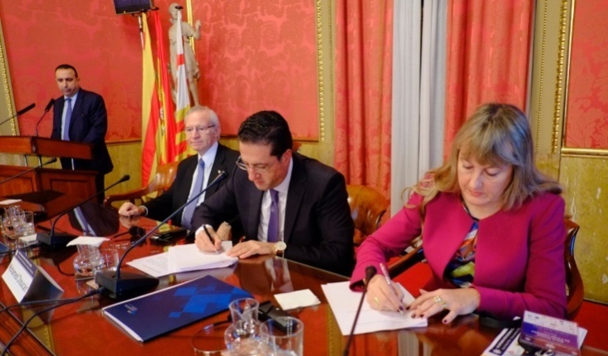
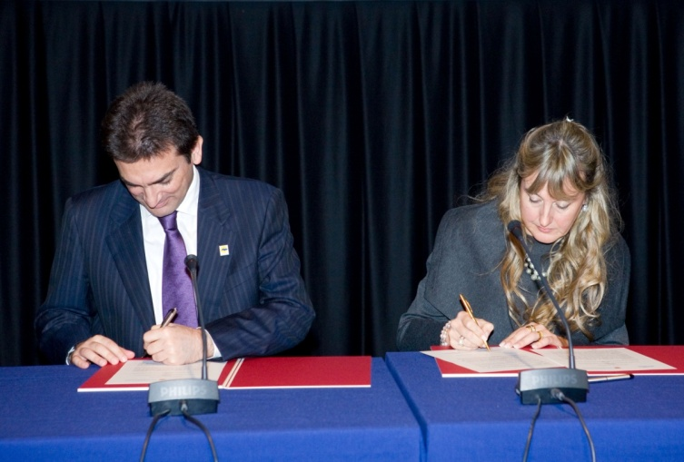

AFAEMME COOPERATION
WITH ASCAME (ASSOCIATION OF THE MEDITERRANEAN CHAMBER OF COMMERCE AND INDUSTRY
On the 12th of November, 2008 AFAEMME has signed with ASCAME a cooperation agreement to strength the economic cooperation throughout the Mediterranean Region, expressing a strategic vision of North-South cooperation and integration.
AFAEMME also contributes to the work of ASCAME’s Women Entrepreneurs Commission which has per missions:
-the promotion of woman entrepreneurship;
-the performance of woman managed companies;
-the integration of new generations of young women entrepreneurs in the association’s life.

Slide 9
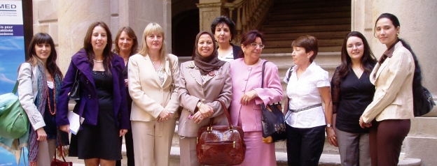

AFAEMME COOPERATION
WITH ANIMA INVESTMENT NETWORD
In June 2010 AFAEMME was nominated Treasurer of the Board of Directors of the ANIMA Investment Network, a multi-country platform for the economic development of the Mediterranean.
AFAEMME also collaborates with ANIMA in the implementation of regional projects, aiming at promoting the Mediterranean’s economic growth and the business cooperation between both shores of the Mediterranean.

Slide 10


AFAEMME COOPERATION
WITH ECONOMIC AND SOCIAL COUNCIL
In July 2011 the United Nations Economic and Social Council (ECOSOC) adopted the recommendation of the Committee on Non-Governmental Organizations (NGOs) to grant special consultative status to AFAEMME.
ECOSOC serves as the central forum for discussing international economic and social issues, and for formulating policy recommendations addressed to Member States and the United Nations system.

Slide 11
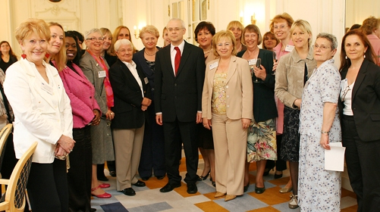
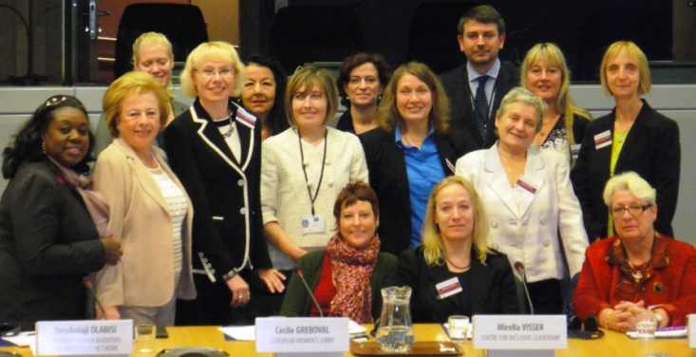
AFAEMME COOPERATION
WITH EUROPEAN NETWORK OF WOMEN IN DECISION MAKING
The European Commission’s Network of Women in Decision-making in Politics and the Economy, launched in June 2008, is an initiative of the former EU Commissioner for Employment, Social Affairs and Equal Opportunities, active in promoting the advancement of women, especially in decision-making positions.
Mª Helena De Felipe Lehtonen, AFAEMME’s President, is member of the network.

Slide 12
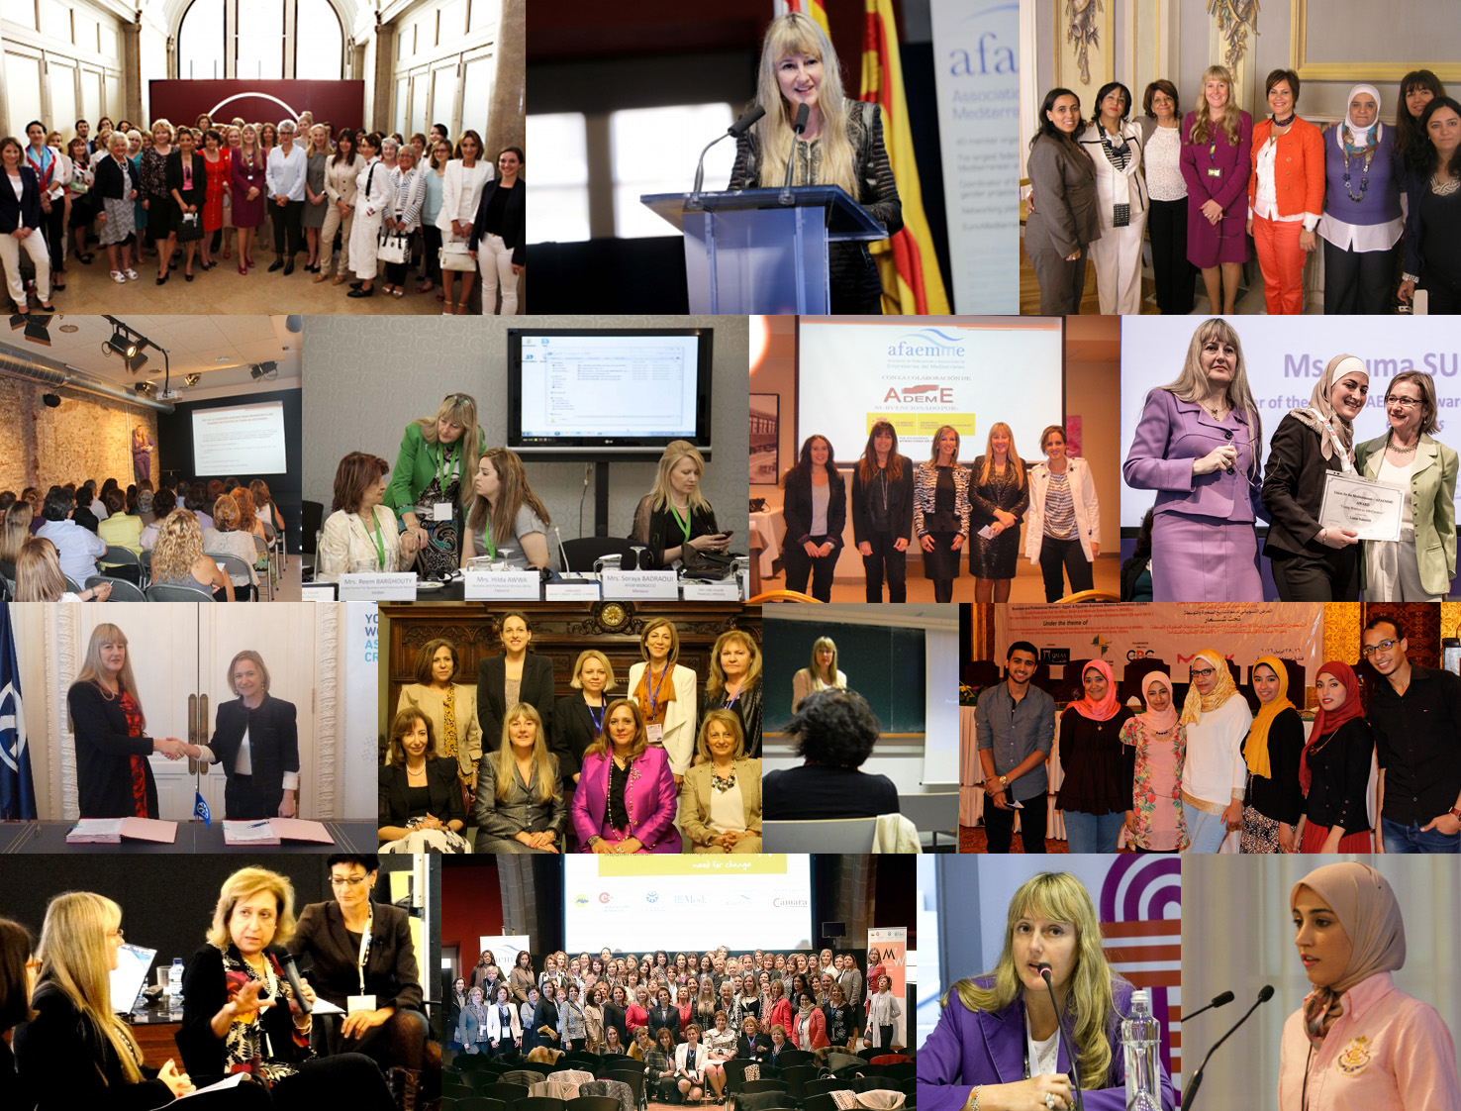
OBJECTIVES
AFAEMME ORGANISATION
PROMOTE
THE PRINCIPLE OF EQUAL OPPORTUNITIES IN THE LABOR MARKET
.
SUPPORT
THE DEVELOPMENT OF RELATIONS AMONG WOMEN ENTREPRENEURS OF THE REGION BY PROMOTING BUSINESS AND TRAINING OPPORTUNITIES
IMPROVE
THE SOCIOECONOMIC CONDITIONS OF WOMEN BY ELIMINATING GENDER DISCRIMINATION
EXERCISE
INFLUENCE ON THE PUBLIC OPINION THROUGH EVENTS, CAMPAIGNS AND LOBBYING TO AUTHORITIES IN ORDER TO STRENGTHEN THE LEGAL, SOCIAL AND ECONOMIC CONDITIONS OF WOMEN
CONTRIBUTE
TO THE ACCESS OF WOMEN TO DECISION-MAKING POSITIONS IN THE ECONOMY BY ENHANCING THEIR BUSINESS AND MANAGEMENT ABILITIES

Slide 13

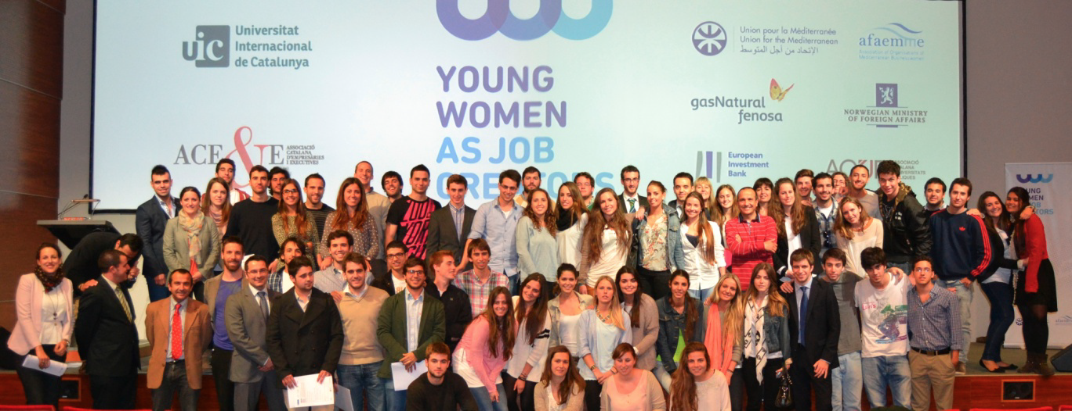

MEDITERRANEAN
PROJECTS

Slide 14





Slide 15

THE PROJECT
“Young Women as Job Creators” promoted self-employment
and entrepreneurship among young women university students
who were about to graduate and who had an interest in starting
their own business in
albania
Egypt
Jordan
Morocco
Palestine
Spain.
By facilitating the transition of these young, talente
women from education to work, the project advocates a
stronger role of women in the social and economic
development of the region, additionally contributing towards
gender equality in the Mediterranean

Slide 16
THE PROJECT
The major objectives which should be targeted through the Euro-Mediterranean cooperation were further detailed during the Global Entrepreneurship Summit held in 2011 instanbul.
The report on Promotion of entrepreneurship, innovation and creativity in the Euro Mediterranean which was passed during the Summit, highlights the need to enhance the business sector development due to:
the existing deficit of entrepreneurs in the region and the important role enterprises and entrepreneurs
play as agents for growth and wealth and as job creators.

Slide 17
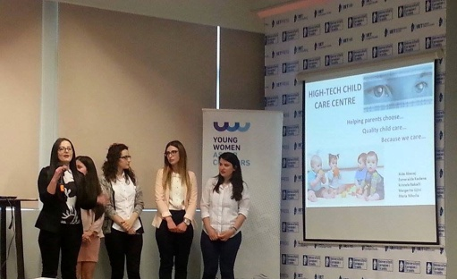
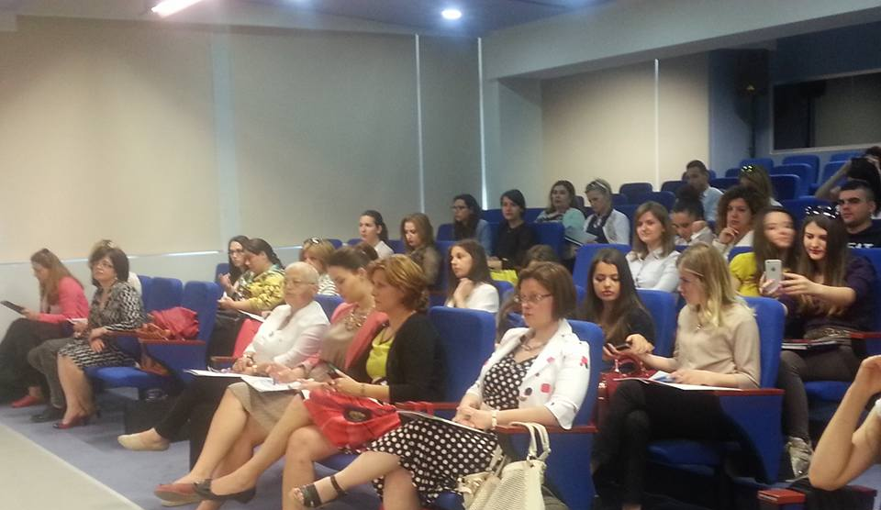
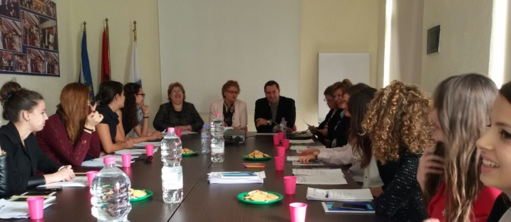
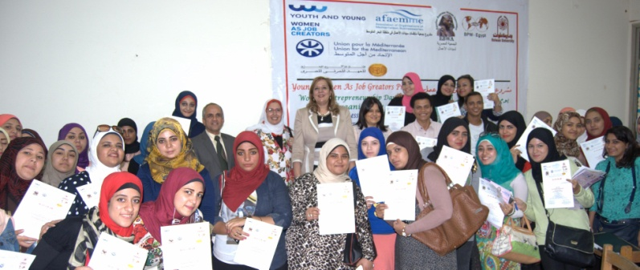
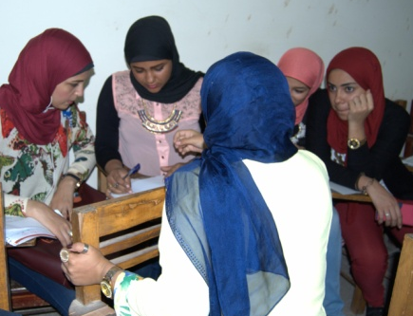
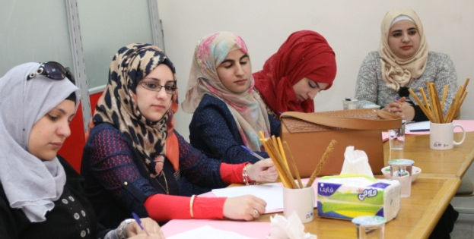
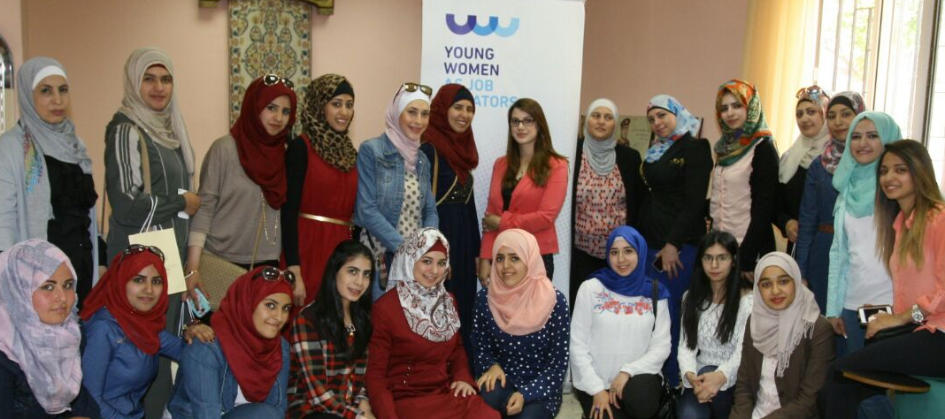
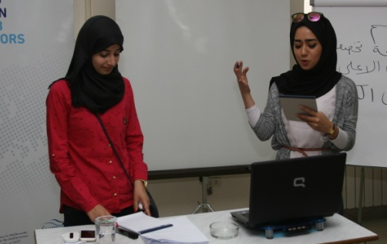
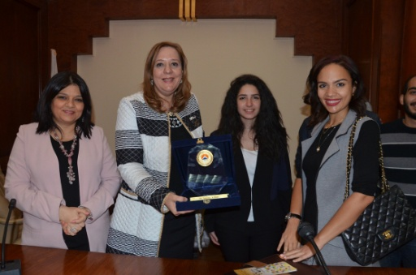

Slide 18
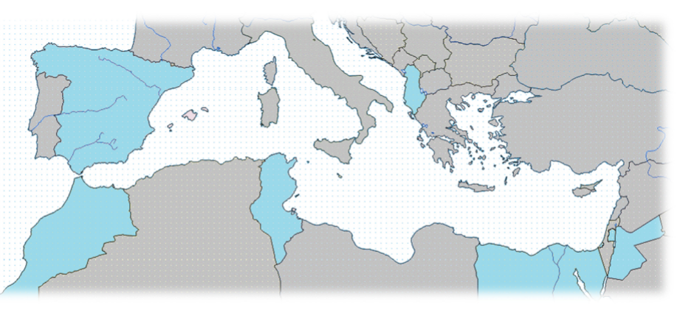
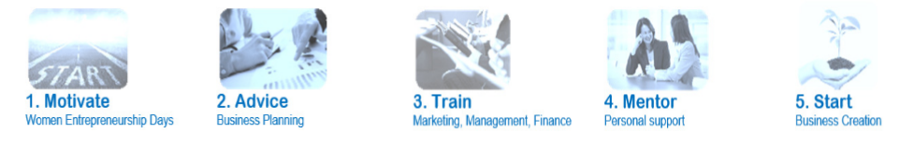
THE PROJECT GOALS

Slide 19

ACCELERATING BUSINESS GROWTH
BY GENDER
BALANCE IN DECISION-MAKING

Slide 20
THE PROJECT
THE “SHE DECIDES, YOU SUCCEED” PROJECT BEGAN IN 2013, AS
A RESULT OF THE SLOW INCORPORATION OF WOMEN INTO TOP MANAGEMENT AND LEADERSHIP POSITIONS IN THE EUROPEAN BUSINESS WORLD.
WITH THE OBJECTIVE OF PROMOTING WOMEN’S ACCESS TO DECISION-MAKING POSITIONS,WE HAVE ANALYZED THIS SITUATION AND IDENTIFIED THE BENEFITS THE PRIVATE SECTOR COULD ENJOY AS A RESULT OF A GREATER FEMALE PRESENCE IN POSITIONS OF ECONOMIC LEADERSHIP WITHIN COMPANIES.
THE ASSOCIATION OF ORGANIZATIONS OF MEDITERRANEAN BUSINESSWOMEN (AFAEMME) HAS HEADED THE PROGRAM THROUGH THE YEARS (2014- 2016) AND STRUCTURED IT AS TWO PHASES.

Slide 21




PHASE I
GUIDES RESULTS

Slide 22
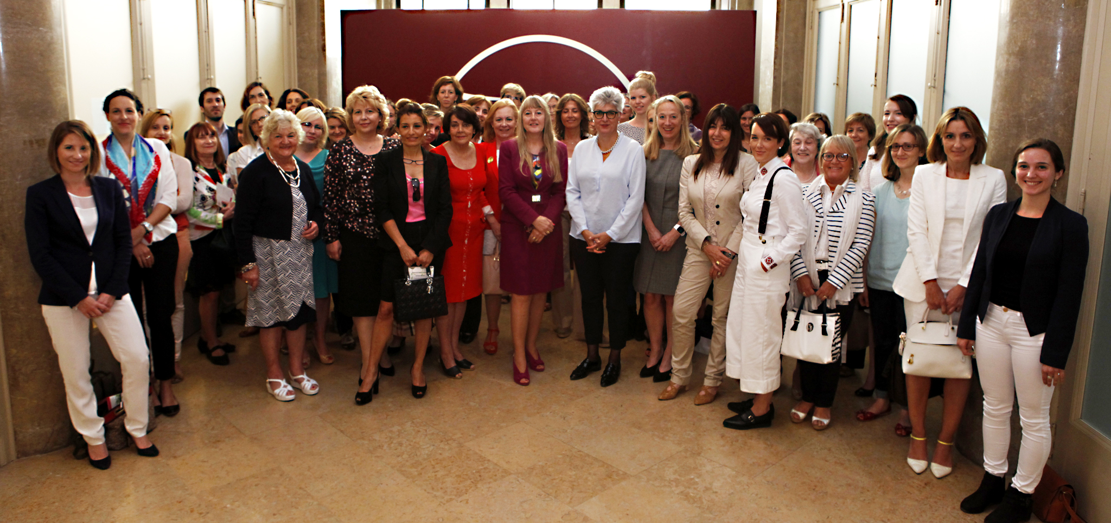









Slide 23

www.afaemme.org

